Slide 1

CS 577 Deep Learning
Instructor: Dr. Yan Yan
Email: yyan34@iit.edu

Slide 2
Course Information
Instructor: Dr. Yan Yan
Office: STUART 237C
Office hours: Before/after class or By appointment
Email: yyan34@iit.edu
Lecture: Wednesday / Friday 1:50pm-3:05pm
Location: RE Building 104
TAs: handle all homework questions and python coding questions
Weitai Kang, wkang11@hawk.iit.edu
Junyi Wu, jwu125@hawk.iit.edu
Gengyu Zhang, gzhang32@hawk.iit.edu

Slide 3
Course Information (Cont’d)
Course textbook
Deep Learning,
by Ian Goodfellow, Yoshua Bengio and Aaron Courville, 2016

Slide 4
Course Information (Cont’d)
Topics (tentative)
Topic 1. Class Introduction [Slides]
Topic 2. Deep Learning Introduction [Book]
Topic 3. Backpropagation [Book]
Topic 4. Convolutional Neural Networks (CNNs) [Slides / Papers]
Topic 5. Deep Learning Tips [Slides / Papers]
Topic 6. Recurrent Neural Network (RNNs) [Slides / Papers]
Topic 7. Generative Adversarial Networks (GANs) [Slides / Papers]
Topic 8. Variational Auto Encoder (VAE) [Slides / Papers]
Topic 9. Diffusion Model [Slides / Papers]
Topic 10. Network Compression [Slides / Papers]
Topic 11. Self-attention [Slides / Papers]
Topic 12. Transformer [Slides / Papers]
Topic 13. Self-supervised Learning [Slides / Papers]
Topic 14. Explainable AI [Slides / Papers]
Prerequisite
Knowledge of machine learning basics.
Familiar with the basic probability theory and the basic linear algebra.

Slide 5
Course Information (Cont’d)
Machine learning and deep learning is a math intensive class.
Grading
Assignments: 30% ( 3-4 assignments )
Mid-term: 20%
Final Exam: 20%
Final Project: 30%
(Grades: A is 90+, B is 80+, C is 70+, D is 60+)
Course Martials
Blackboard

Slide 6
Course Information (Cont’d)
Programming language
Python
https://machinelearningmastery.com/machine-learning-in-python-step-by-step/
LaTex
You are strongly encouraged to use LaTex for the project proposal and reports.
https://www.overleaf.com/
GitHub
https://guides.github.com/activities/hello-world/
A centralized place to store and track all code related to your project.
A principled way to collaborate with team members.

Slide 7
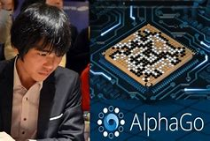
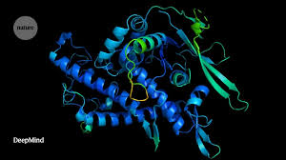

Deep Learning in Our Daily Life
The latest version of our AI system AlphaFold has been recognized as a solution to this grand challenge by the organizers of the biennial Critical Assessment of protein Structure Prediction (CASP). This breakthrough demonstrates the impact AI can have on scientific discovery and its potential to dramatically accelerate progress in some of the most fundamental fields that explain and shape our world.
AlphaGo is the first computer program to defeat a professional human Go player, the first program to defeat a Go world champion, and arguably the strongest Go player in history.

Slide 8
Deep Learning Applications

Slide 9
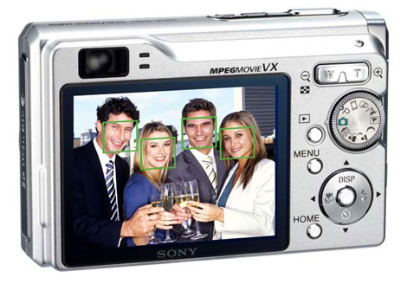
Face detection
Most digital cameras and smart phones detect faces - Canon, Sony, Fuji, …
For smart focus, exposure compensation, and cropping
Slide credit: Steve Seitz

Slide 10
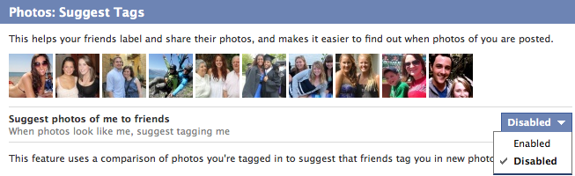
Face recognition
Facebook face auto-tagging

Slide 11
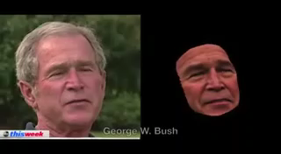
Face Landmark Alignment
What Makes Tom Hanks Look Like Tom Hanks ICCV 2015

Slide 12
Smile Detection
Sony Cyber-shot® T70 Digital Still Camera
Slide credit: Steve Seitz

Slide 13
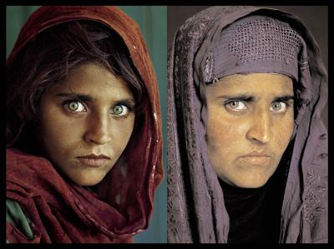
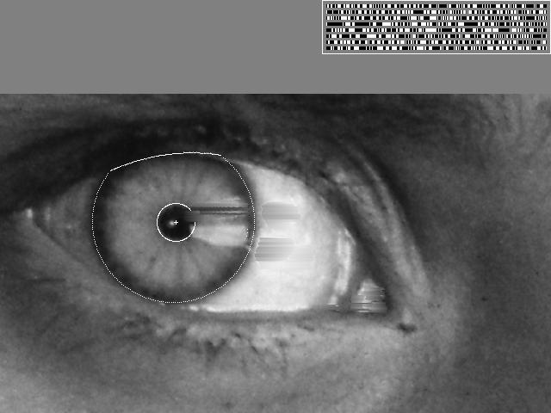
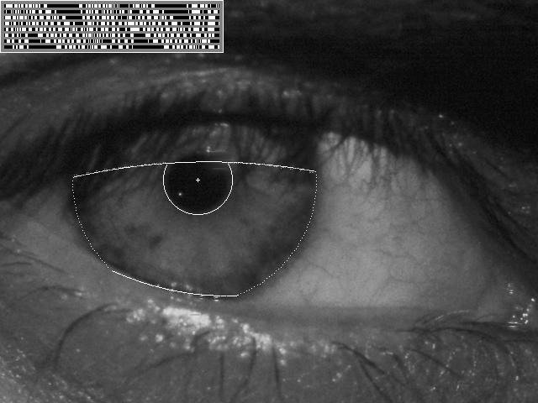
Vision-based Biometrics
“How the Afghan Girl was Identified by Her Iris Patterns”
Slide credit: Steve Seitz

Slide 14
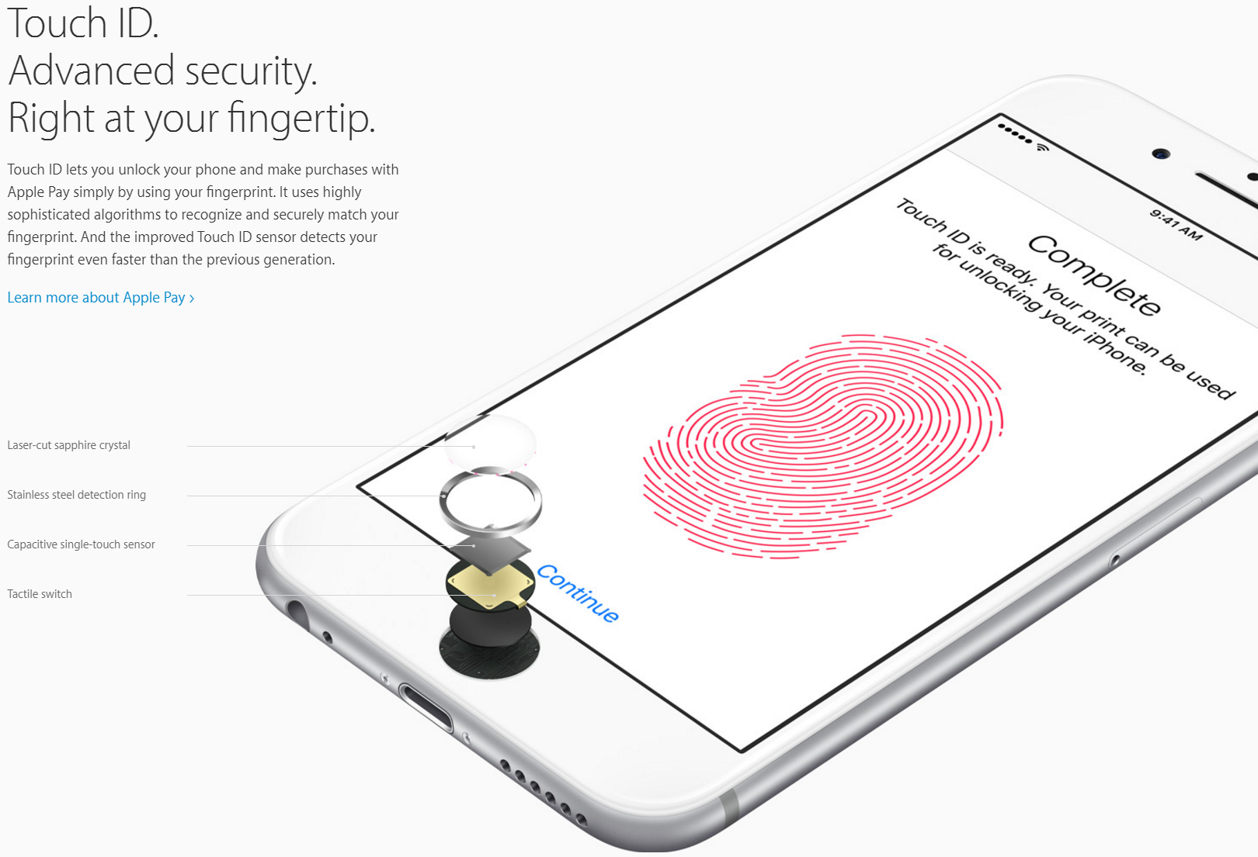
Vision-based Biometrics

Slide 15

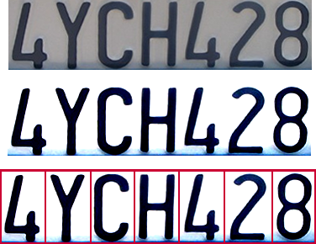
Optical Character Recognition (OCR)
Technology to convert scanned docs to text
If you have a scanner, it probably came with OCR software
Digit recognition, AT&T labs
http://www.research.att.com/~yann
License plate readers
http://en.wikipedia.org/wiki/Automatic_number_plate_recognition
Slide credit: Steve Seitz

Slide 16
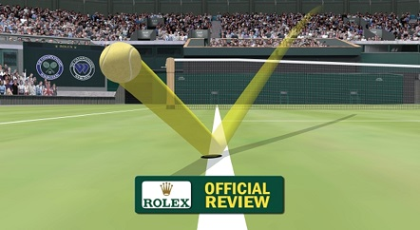
Computer vision in sports
Hawk-Eye: helping/improving referee decisions

Slide 17
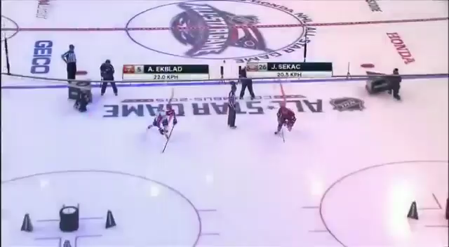
Computer vision in sports
Play tracking

Slide 18
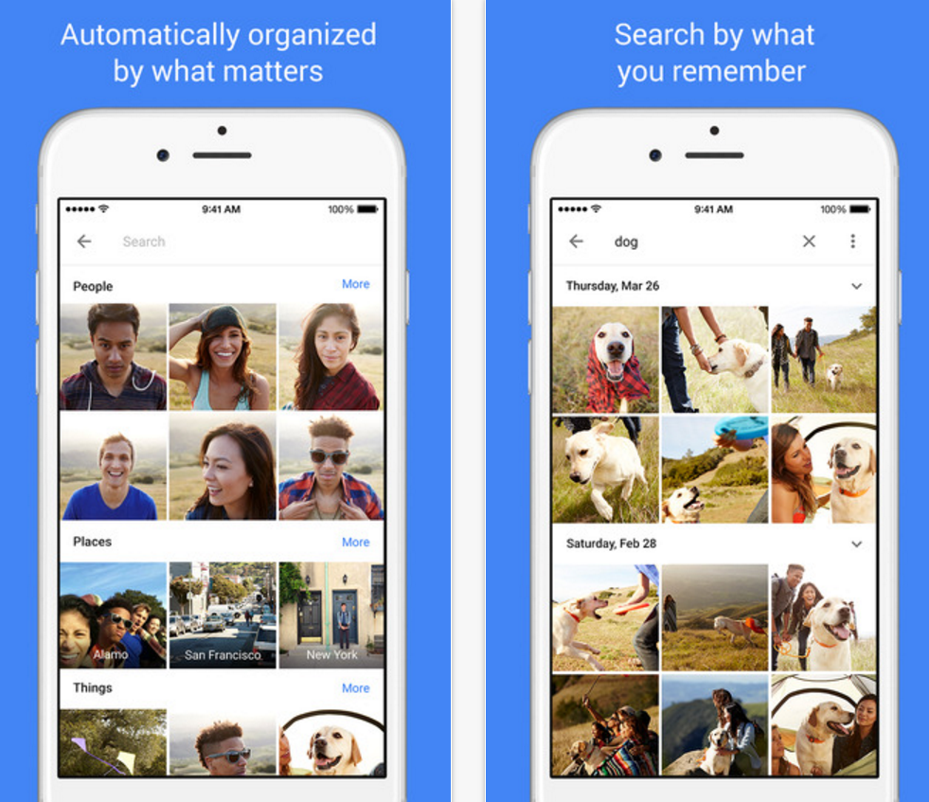
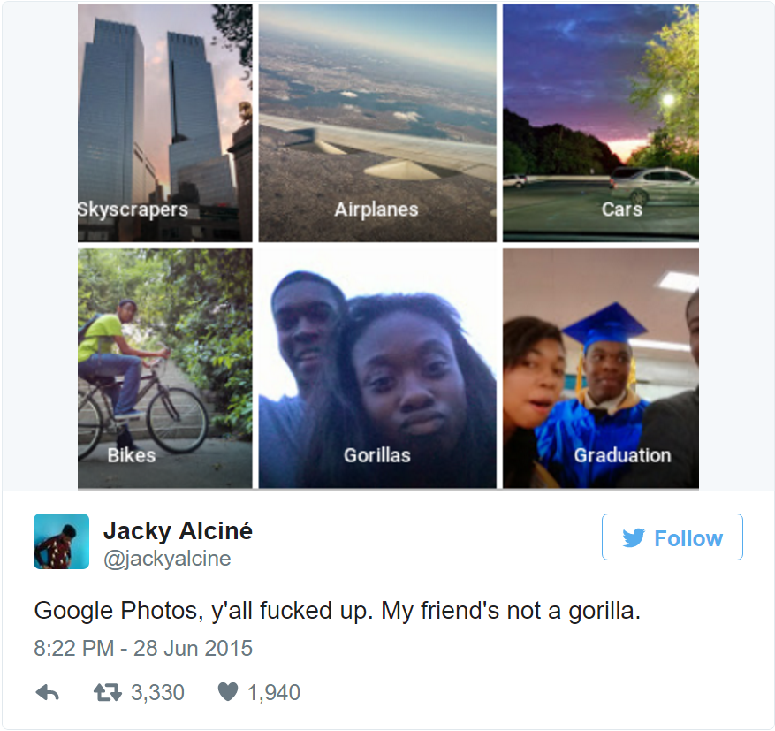
Visual recognition for photo organization
Google photo

Slide 19
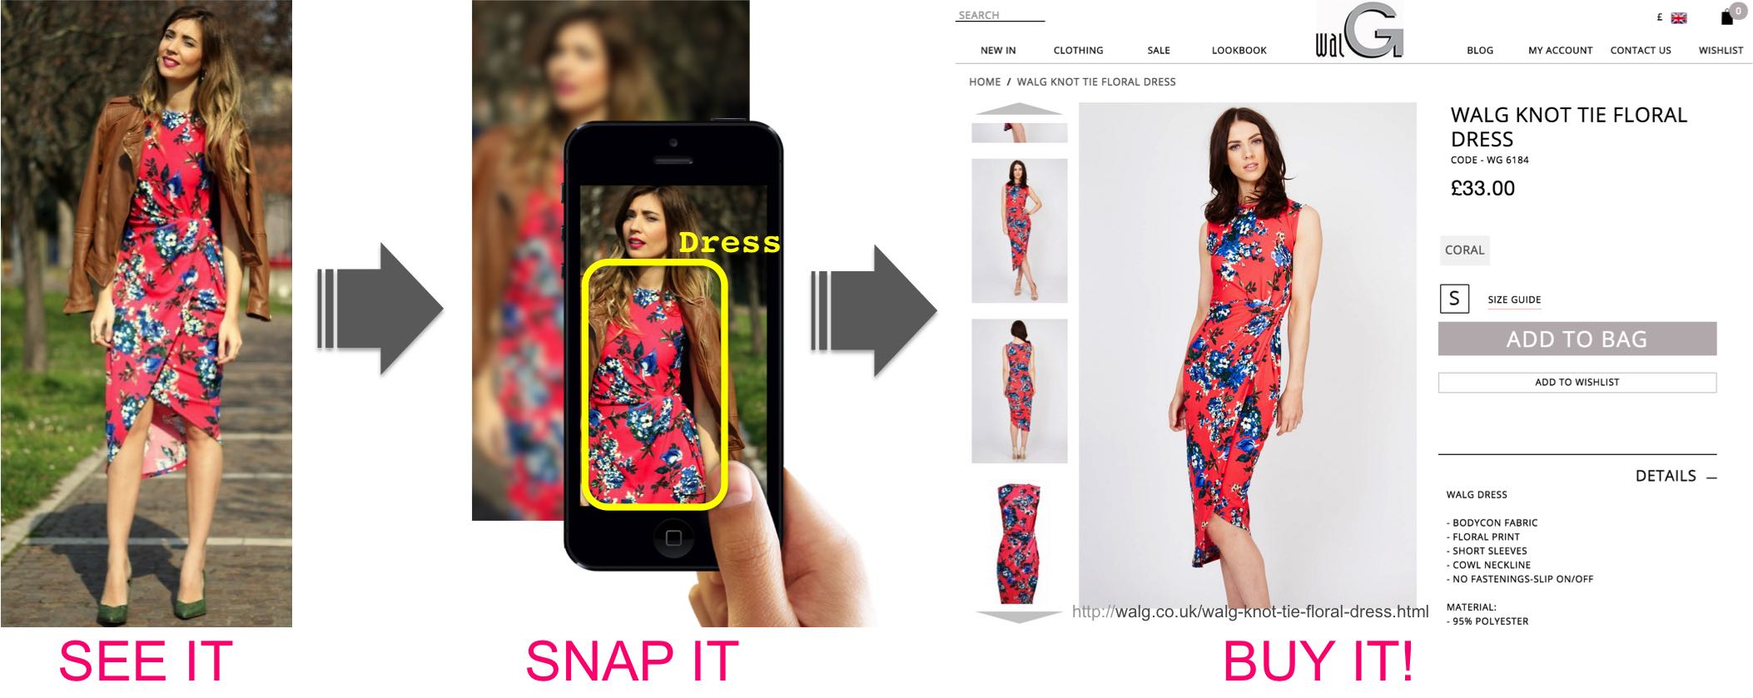
Matching street clothing photos in online Shops
Street2shop, ICCV 2015

Slide 20

3D scanner from a mobile camera
MobileFusion

Slide 21
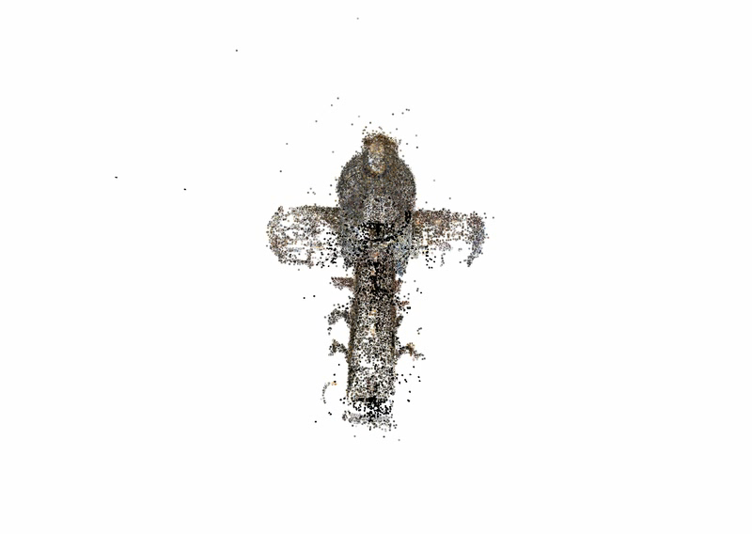
3D from thousands of images
Building Rome in a Day: Agarwal et al. 2009

Slide 22
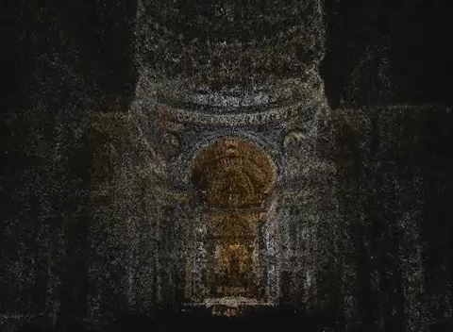
3D from thousands of images
[Furukawa et al. CVPR 2010]

Slide 23
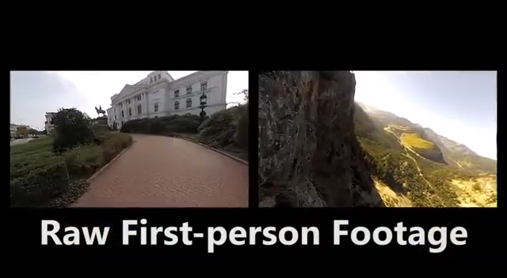
First-person Hyperlapse Videos
[Kopf et al. SIGGRAPH 2014]

Slide 24
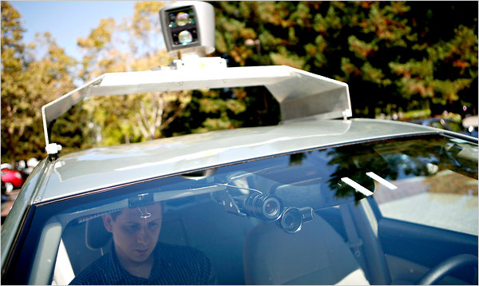
Google cars
Oct 9, 2010. "Google Cars Drive Themselves, in Traffic". The New York Times. John Markoff
June 24, 2011. "Nevada state law paves the way for driverless cars". Financial Post. Christine Dobby

Slide 25
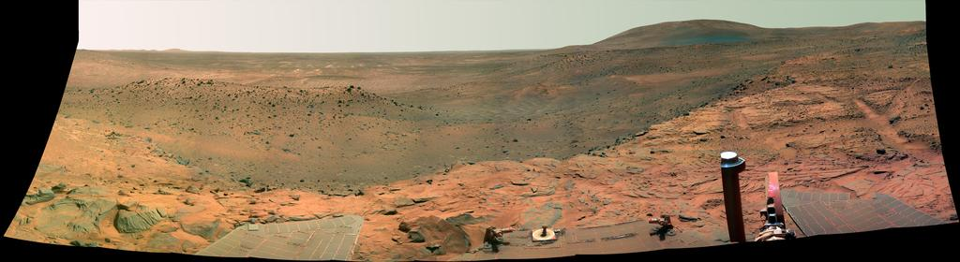
Vision in space
NASA'S Mars Exploration Rover Spirit captured this westward view from a low plateau where Spirit spent the closing months of 2007.
Vision systems (JPL) used for several tasks
Panorama stitching
3D terrain modeling
Obstacle detection, position tracking
For more, read “Computer Vision on Mars” by Matthies et al.

Slide 26
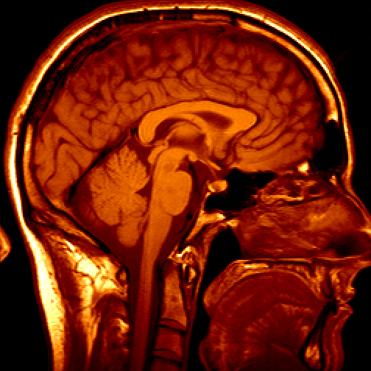
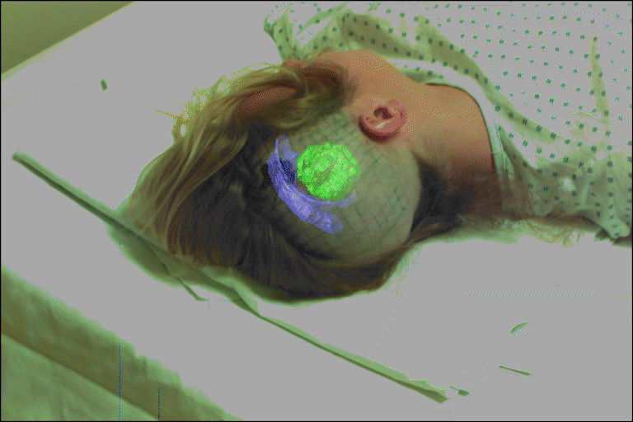
Medical imaging
Image guided surgery
Grimson et al., MIT
3D imaging
MRI, CT

Slide 27
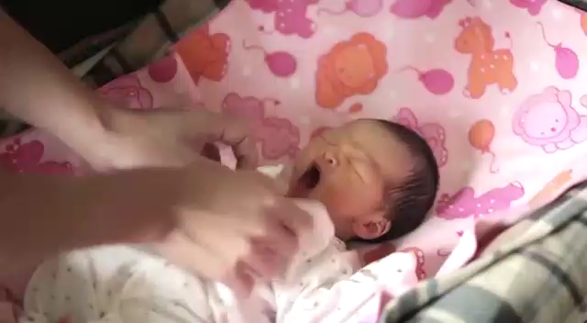
Computer vision for healthcare
BiliCam, Ubicomp 2014

Slide 28
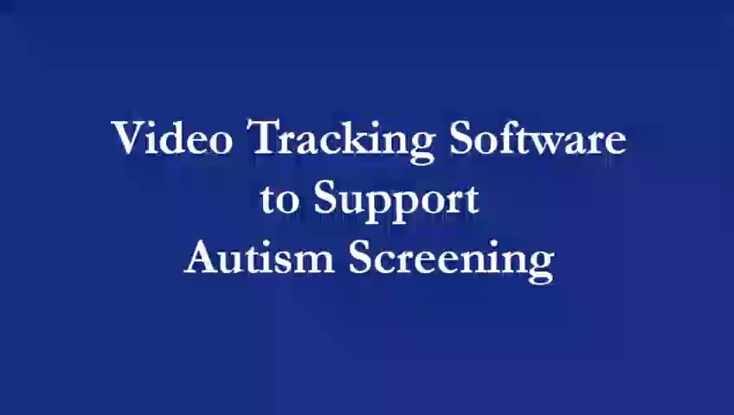
Computer vision for healthcare
Autism Screening

Slide 29
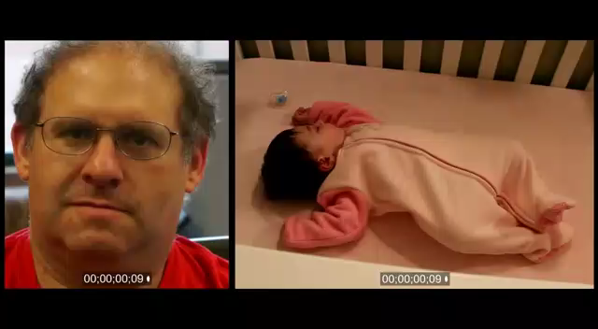
Computer vision for healthcare
Video magnification

